Slide 1
Friends Recommendation on Twitter
CS 6350.001
Big Data
Professor Dr. Latifur Khan
Guangmo Tong
Ruili Yao
Xinwen Zhu

Slide 2
Selected Topic
In this project, we apply big data techniques and machine learning algorithms on Twitter dataset using Spark.

Slide 3
Background
People are always looking for new friends in an online social network.
k-friend recommendation problem: recommend k users sharing similar interest to a certain user on Twitter.

Slide 4
Project Description
Implement two approaches of friends recommendation on Twitter data:
Basic Recommendation
- Jaccard similarity measure
Clustering-enhanced Recommendation
- K-means algorithm (Euclidean distance measure)
- Cosine/Pearson similarity measure

Slide 5
Datasets
twitter_5000_10000.dat: the 10000 who-follow-who relationship of the selected 5000 nodes in matrix format, representing as 1 or 0.
twitter_5000_10000new.dat: the i-th line contains the nodes followed by node i, representing as node_id.
cluster.dat: line i contains the nodes in cluster i.

Slide 6
Script Files
basic_jaccard.scala: the recommendation via jaccard similarity.
cluster.scala: cluster the nodes into 100 clusters by the euclidean distance.
advanced_pearson: recalculate the attribute vector according to the clustering and do the recommendation by pearson similarity.
advanced_cos: recalculate the attribute vector according to the clustering and do the recommendation by cosine similarity.

Slide 7
Basic Recommendation
- Jaccard similarity measure

Slide 8
Definition
Given a user i, the users recommended to i are supposed to be similar to i.
In this project, we develop the measure of similarly based on the who follow who relationship from the dataset.

Slide 9



Definition
For a user i , we define its attribute vector A_{i} as
where implies i follows (resp. does not follow) j.
We define A(i, i) to be 1.

Slide 10
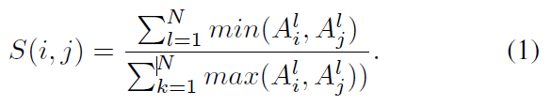
Evaluation
According to the Jaccard similarity measure, the similarity S(i, j) of two users i and j can be defined
A natural approach is to recommend to j the k users that have the largest S(i, j).

Slide 11
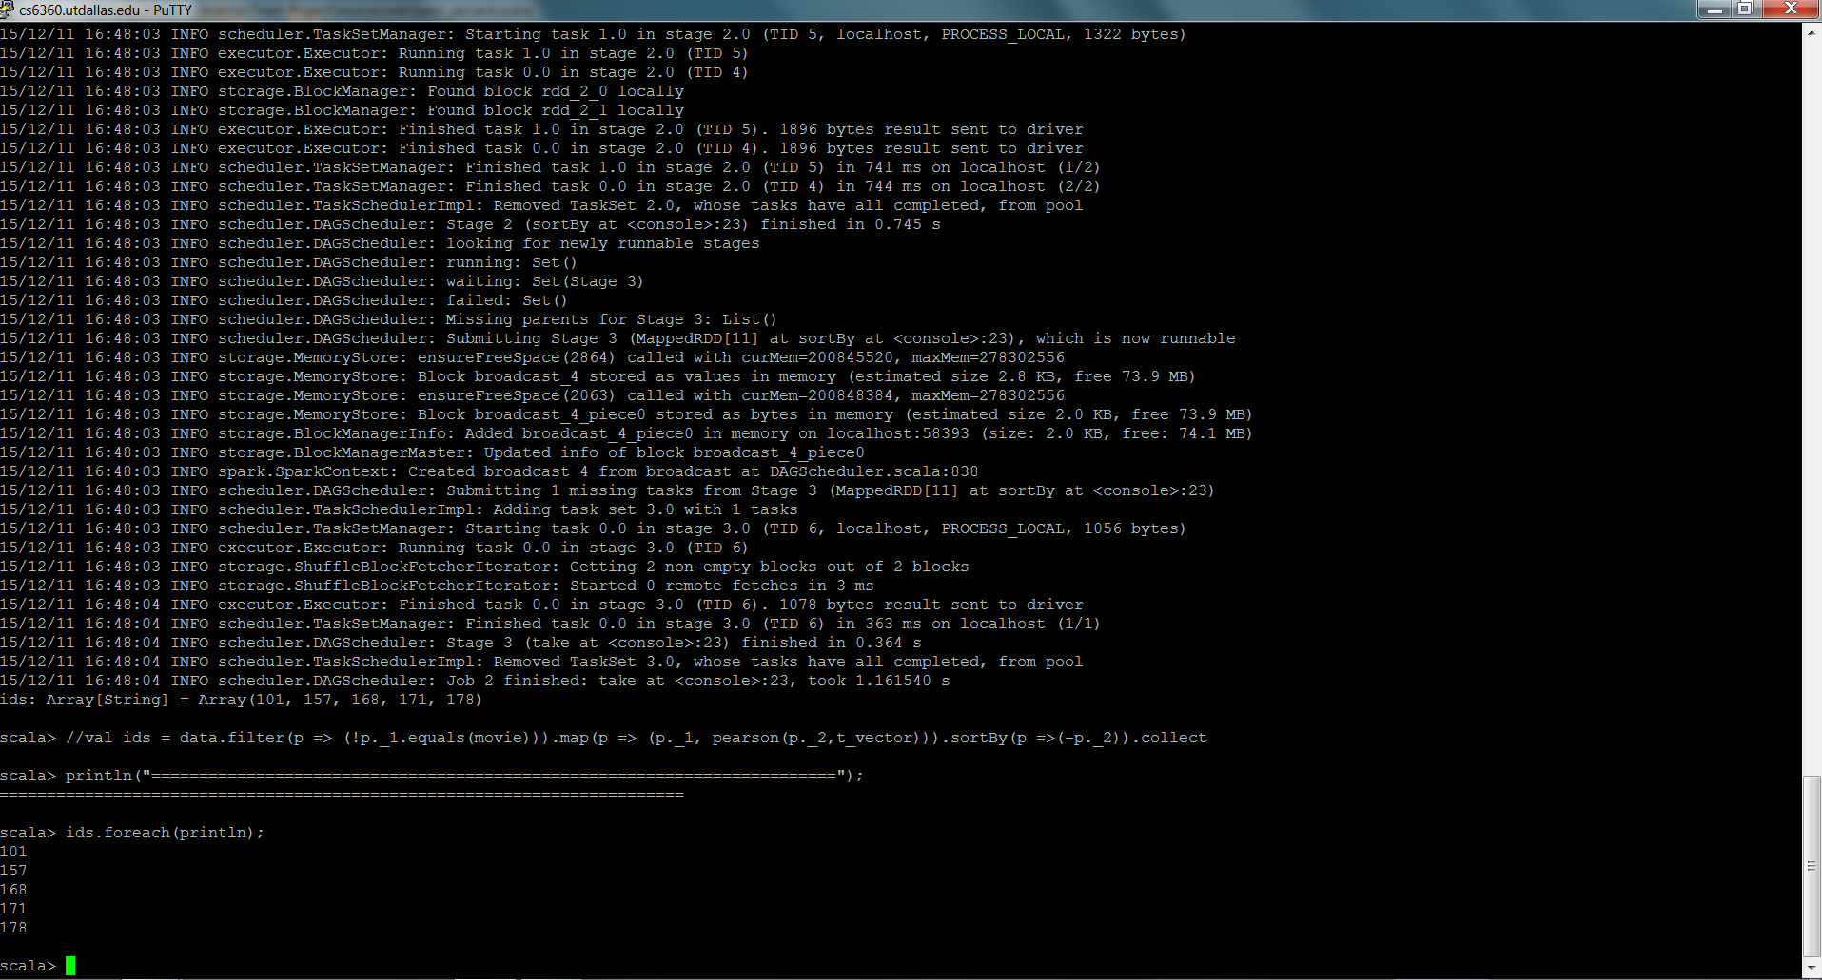
result of basic_jaccard.scala

Slide 12
Drawback of Basic Recommendation
On twitter, a node can be referred to several topics, i.e., sports, news and music.
The basic recommendation approach may magnify a certain topic too much.

Slide 13
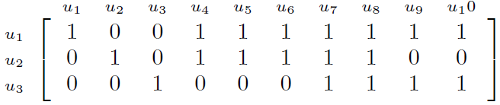
Drawback of Basic Recommendation
Suppose there are ten users u₁ ,…, u₁₀ with the following who-follow-who relationship.
Consider: select one user from u₂ and u₃ to recommend to u₁?

Slide 14
Drawback of Basic Recommendation
JC: S(u₁, u₂) = 5/7 > S(u₁, u₃) = 4/7 => Recommend u₂ !
If: u₄, u₅, u₆ and u₇ are all music pages, and u₈, u₉ and u₁₀ are related to different other topics
Then: u₁ has two common interest with u₂
u₁ has four common interest with u₃.
=> Recommend u₃ !

Slide 15
Clustering-enhanced Recommendation
Two steps:
Topic clustering
K-means algorithm (Euclidean distance measure)
Friend Recommendation
Cosine/Pearson similarity measure

Slide 16
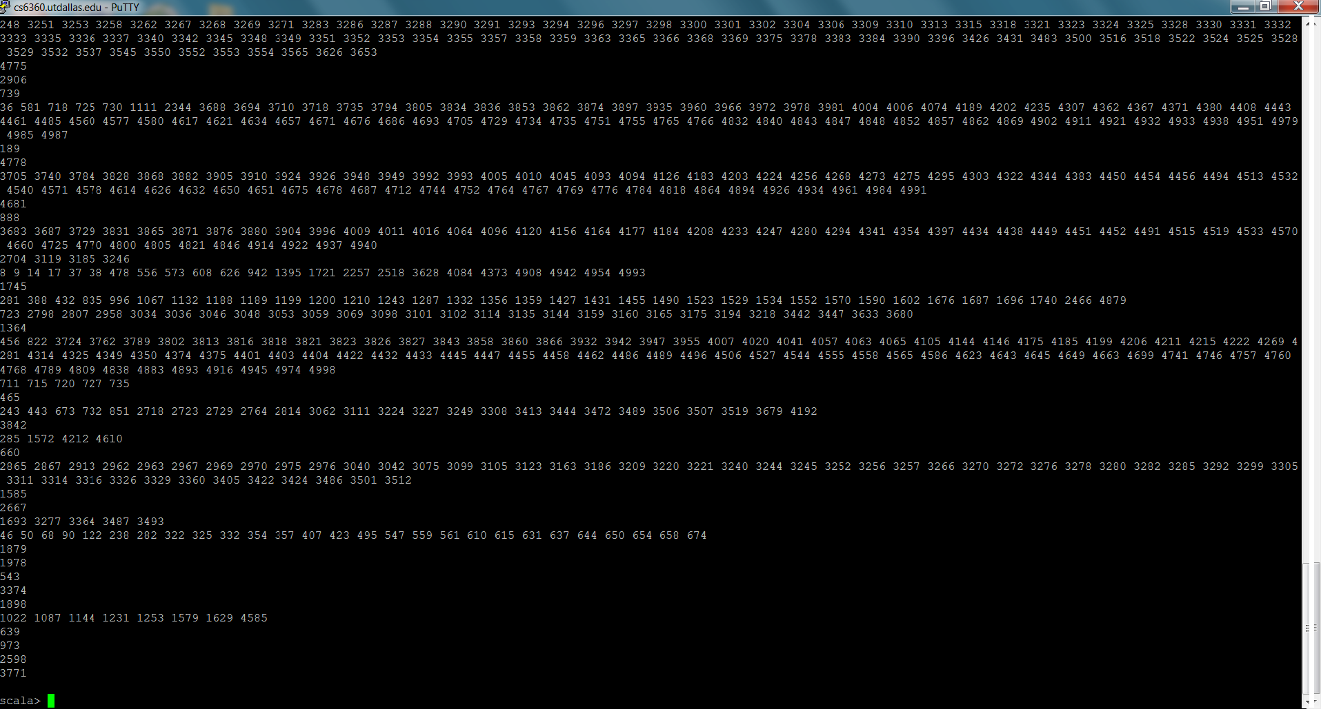
Topic clustering
Clustering the users into 100 clusters by the k-means algorithm, where the distance of two users is calculated by the Euclidean distance.
result of cluster.scala

Slide 17
Friend Recommendation
- Pearson correlation coefficient
- Cosine similarity measure

Slide 18


Idea
Suppose clusters are C₁, ..., C_{p} where each C_{i} is set of users.
Each cluster servers as a group of similar users. We redefine the attribute vector Ai of user i as follows.
where is the number(1/0) of users in cluster C_{j} followed by user i.
According to the new attribute vector, we compute the similarity of two users by the pearson correlation coefficient or cosine similarity measure.

Slide 19
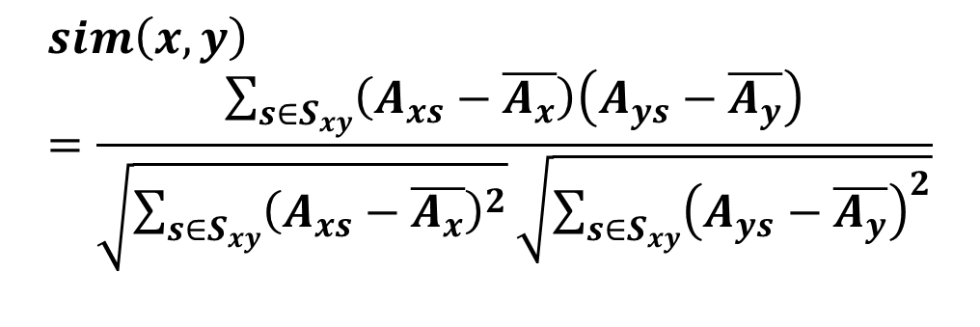

Pearson correlation coefficient
$$sim\left(x,y\right)=\frac{\sum_{s∈S_{xy}}{\left(A_{xs}−\overline{A_{x}}\right)\left(A_{ys}−\overline{A_{y}}\right)}}{\sqrt{\sum_{s∈S_{xy}}{{\left(A_{xs}−\overline{A_{x}}\right)}^{2}}}\sqrt{\sum_{s∈S_{xy}}{{\left(A_{ys}−\overline{A_{y}}\right)}^{2}}}}$$
Where $\overline{A_{x}}$ and $\overline{A_{y}}$ are the averages of attribute vector lists of user x and y respectively.

Slide 20
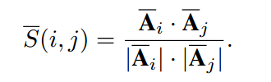
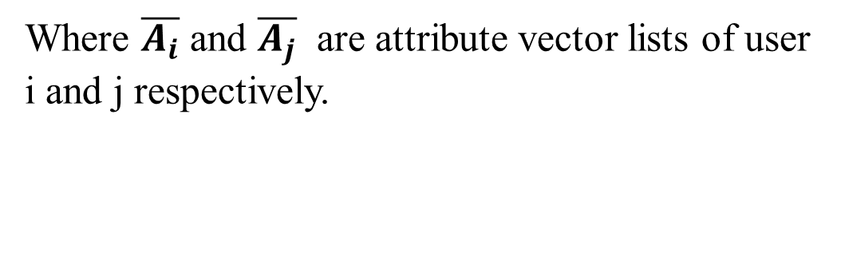
Cosine similarity measure
Where $\overline{A_{i}}$ and $\overline{A_{j}}$ are attribute vector lists of user i and j respectively.

Slide 21
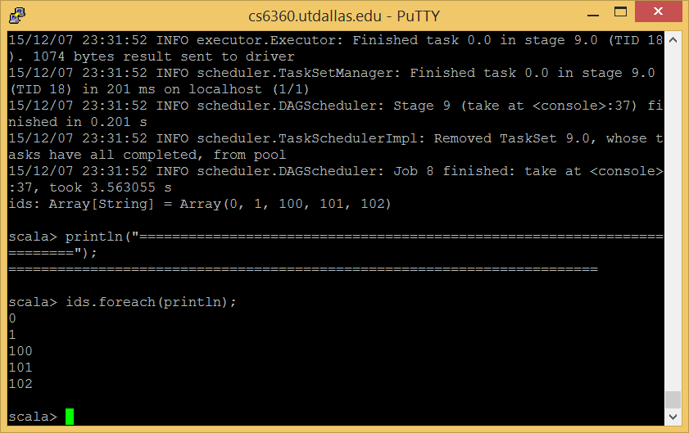
Results
Pearson correlation coefficient
Results after input user id 10

Slide 22
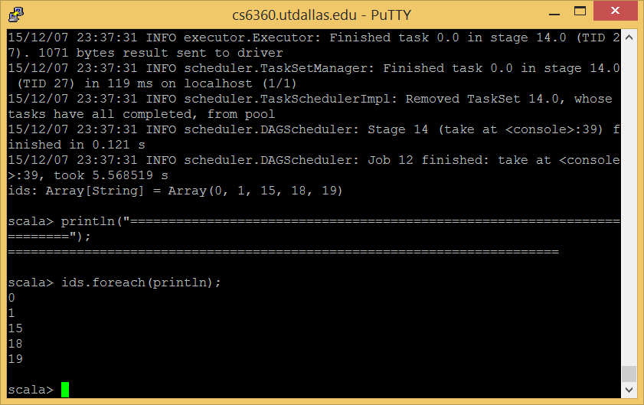
Results
Cosine similarity measure
Results after input user id 10

Slide 23
Thank you!

